Slide 1
APPLICATION
Personalized Pagerank
web search
community detection
link prediction
anomaly detection
recommendation
Notes:
个性化PageRank（PPR）[24]是最广泛使用的措施之一，因其有效性和理论性质而受到广泛关注

Slide 2
RELATED WORKS
Distributed PPV computation[2]
[5] proposes a distributed algorithm based on MapReduce utilizing Monte Carlo simulation
The general graph processing engines, such as Pregel [35], Pregel+ [47] and Blogel [46], can be used for various distributed graph processing.

Slide 3
Distributed Algorithms on Exact Personalized PageRank
MOTIVATION
the high computational cost and space cost of computing the exact Personalized PageRank Vector (PPV)
Most existing works [24, 5, 14, 43, 49] sacrifice the accuracy to accelerate PPV computation.
Notes:
精确个性化PageRank上的分布式算法[2]
计算精确个性化PageRank向量（PPV）的高计算成本和空间成本
大多数现有作品[24,5,14,43,49]牺牲了准确性来加速PPV计算。

Slide 4
Distributed Algorithms on Exact Personalized PageRank
CHALLENGE
it is still a very challenging task to compute exact PPVs efficiently for different online applications.
pre-compute the PPV for each node is impractical because of both the expensive pre-computation time and the offline storage requirements
Notes:
对于不同的在线应用，有效地计算精确的PPV仍然是一项非常具有挑战性的任务。
由于昂贵的预计算时间和离线存储要求，预先计算每个节点的PPV是不切实际的

Slide 5
Distributed Algorithms on Exact Personalized PageRank
CONTRIBUTIONS
Efficiency: Our proposed algorithm HGPA is 10 ∼ 100 times faster than the power iteration approach, and can meet the efficiency need of online applications.
Accuracy
Load Balance: the runtime can be reduced nearly by half if we double the number of machines.
Low Communication Cost: Our algorithms only require one time of communication between each machine and the coordinator, and no communication between any two machines is needed for pre-computation and query processing.

Slide 6
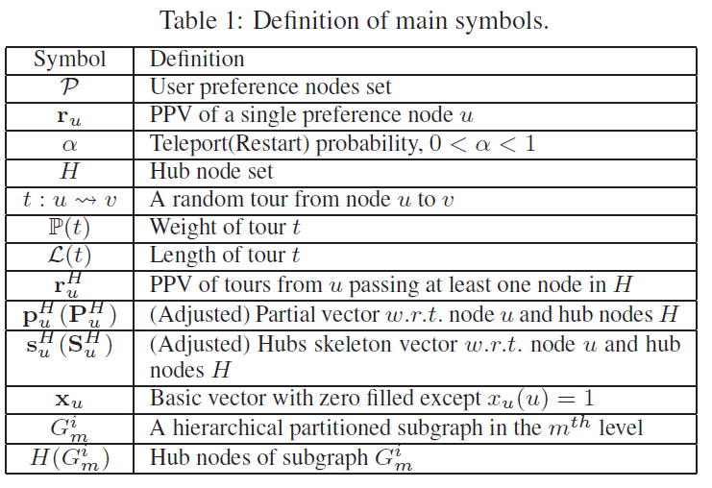
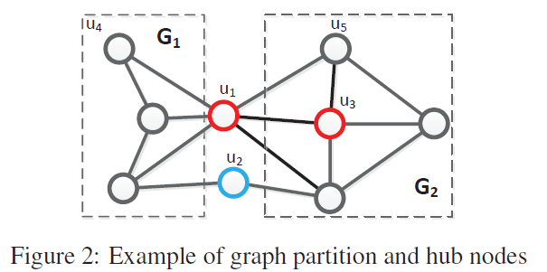
Distributed Algorithms on Exact Personalized PageRank

Slide 7
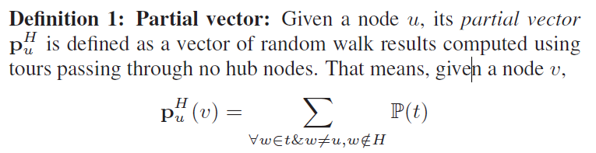

Distributed Algorithms on Exact Personalized PageRank
Partial vector

Slide 8
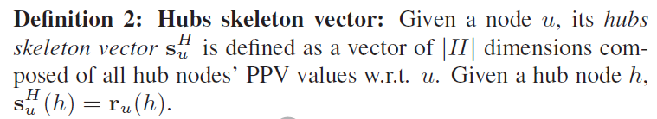

Distributed Algorithms on Exact Personalized PageRank
Hubs skeleton vector

Slide 9
Distributed Algorithms on Exact Personalized PageRank
ALGORITHM GPA
a balanced graph partition algorithm (METIS [25])
the PPV construction of the method [24]

Slide 10
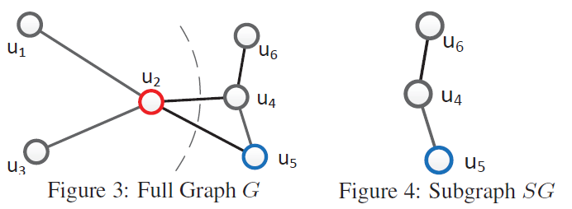
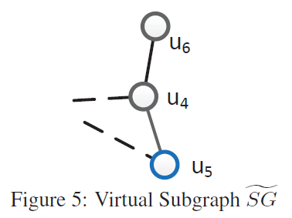
Distributed Algorithms on Exact Personalized PageRank
ALGORITHM HGPA
Partial Vector vs Local PPV
Virtual subgraph

Slide 11
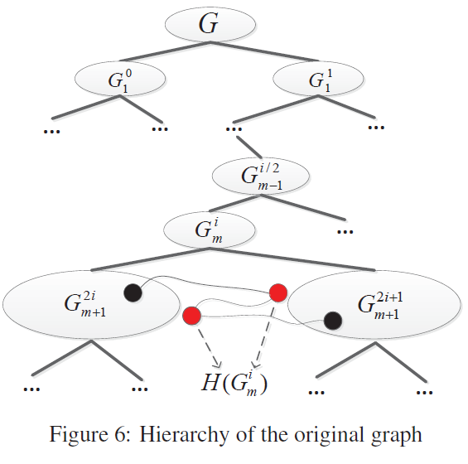
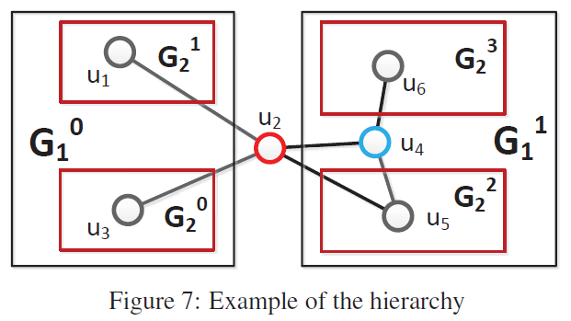
Distributed Algorithms on Exact Personalized PageRank
Hierarchical Graph Partitioning
the 2-way partitioning algorithm [25]
recursively apply GPA, until we reach a level such that no edges exist within the same subgraph

Slide 12
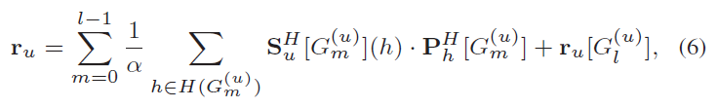
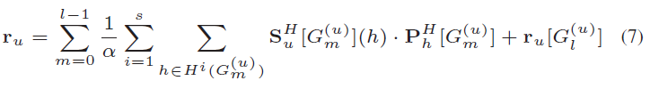
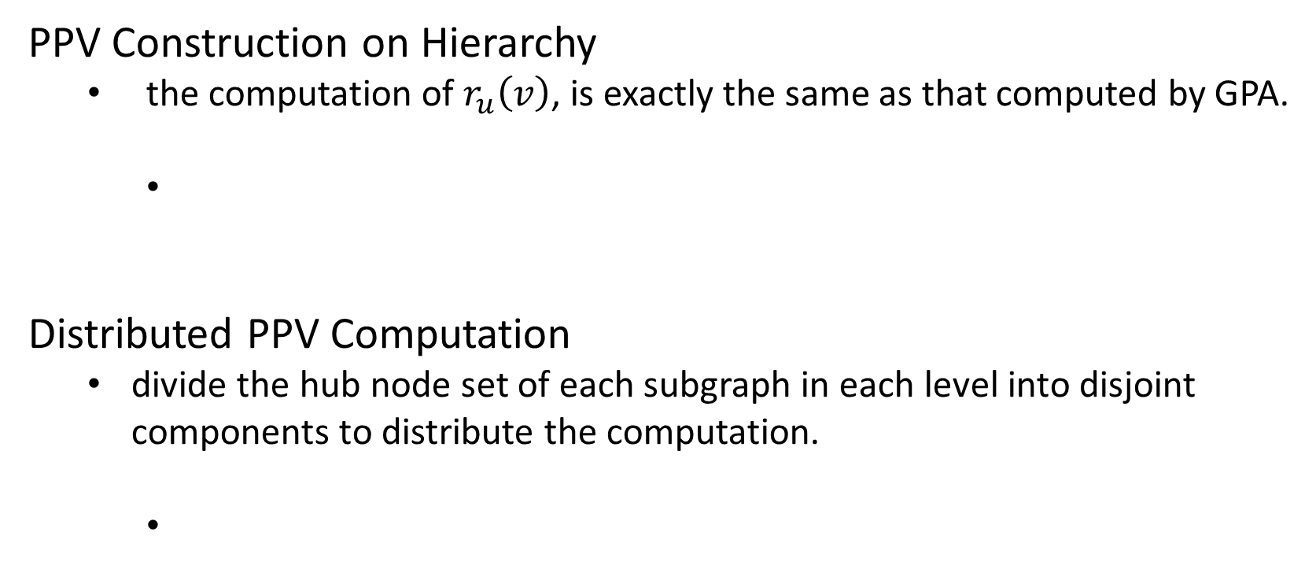
Distributed Algorithms on Exact Personalized PageRank
PPV Construction on Hierarchy
the computation of $r_{u}\left(v\right)$, is exactly the same as that computed by GPA.
Distributed PPV Computation
divide the hub node set of each subgraph in each level into disjoint components to distribute the computation.
Notes:
这使我们将每个level中每个子图的中心节点集划分为不相交的子集以用于分配计算。

Slide 13
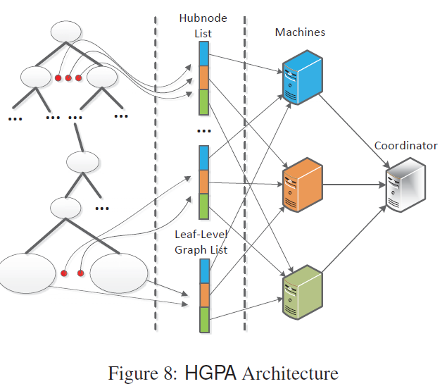
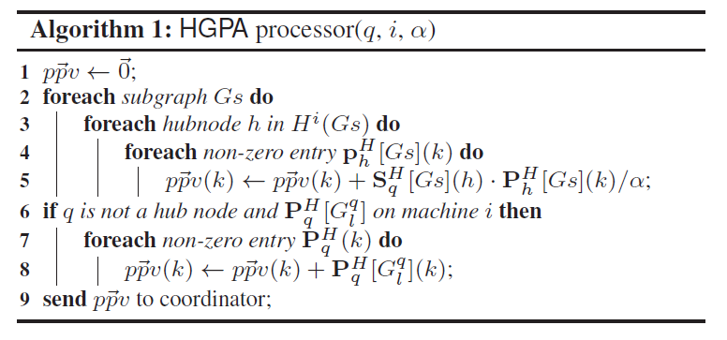
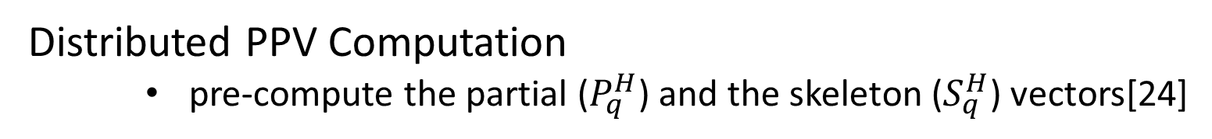
Distributed Algorithms on Exact Personalized PageRank
Distributed PPV Computation
pre-compute the partial ($P_{q}^{H}$) and the skeleton ($S_{q}^{H}$) vectors[24]

Slide 14
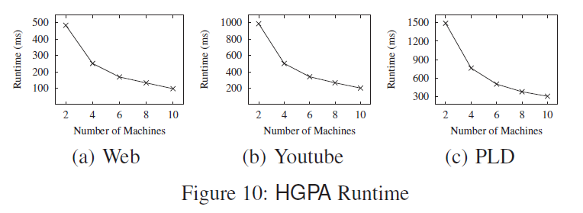
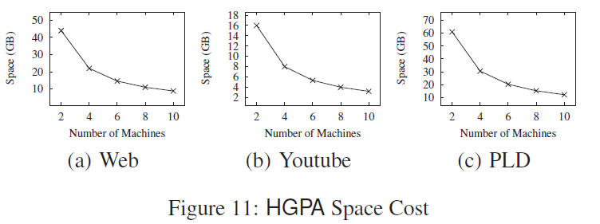
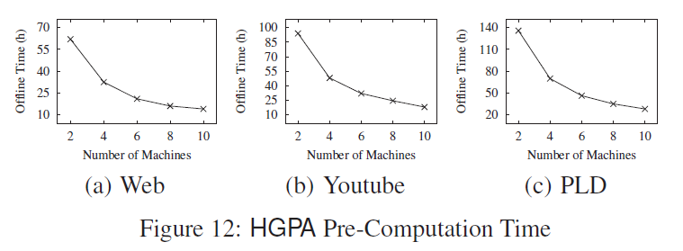
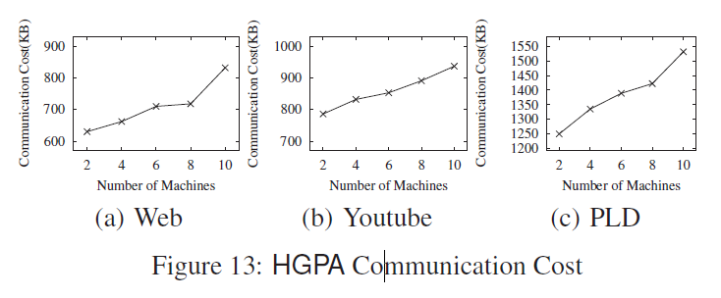
Distributed Algorithms on Exact Personalized PageRank
Experimental Results
Number of Machines

Slide 15
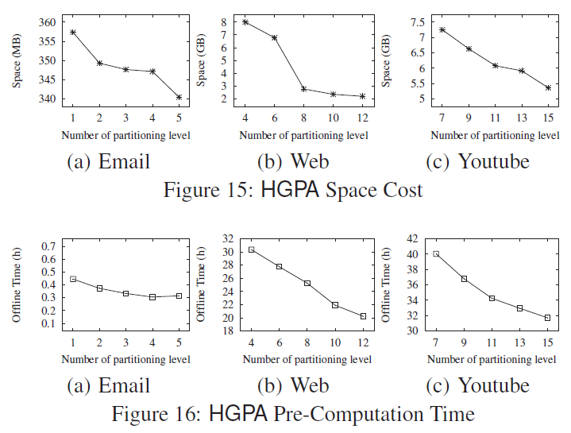
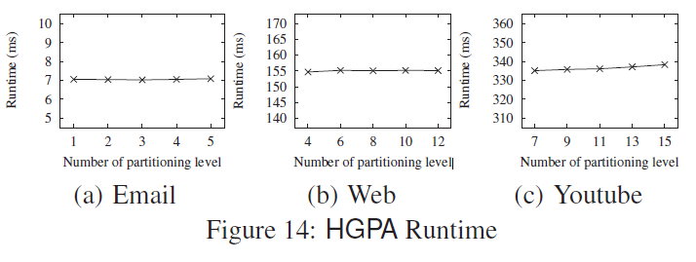
Distributed Algorithms on Exact Personalized PageRank
Experimental Results
Number of Partitioning Levels

Slide 16
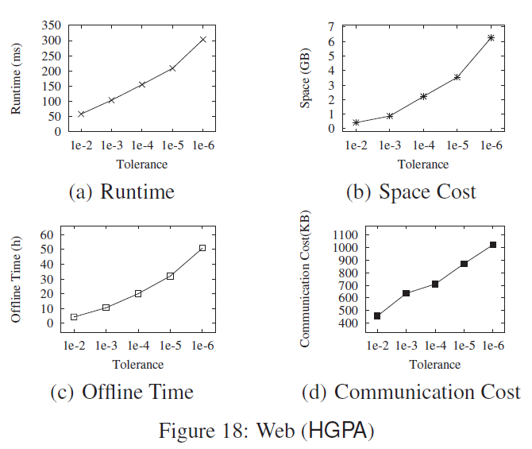

Distributed Algorithms on Exact Personalized PageRank
Experimental Results
Tolerance $ε$

Slide 17
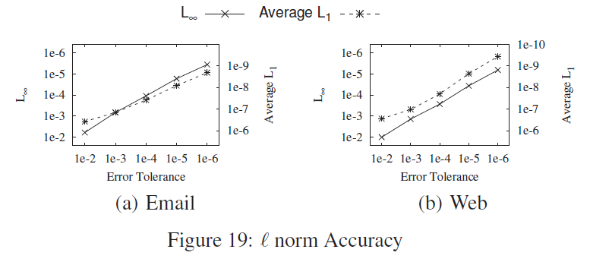
Distributed Algorithms on Exact Personalized PageRank
Experimental Results
Tolerance $ε$

Slide 18
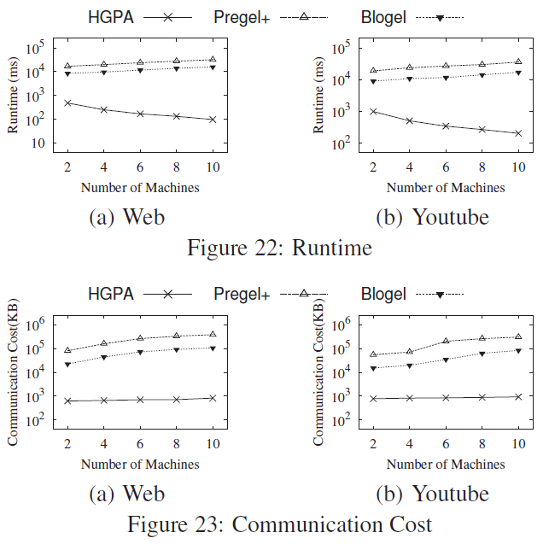
Distributed Algorithms on Exact Personalized PageRank
Experimental Results
BASELINE: the power iteration method implemented on Pregel+ [47] and Blogel [46]

Slide 19
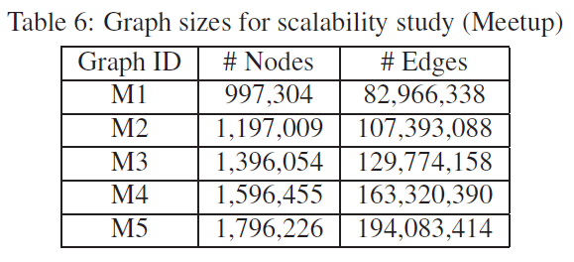
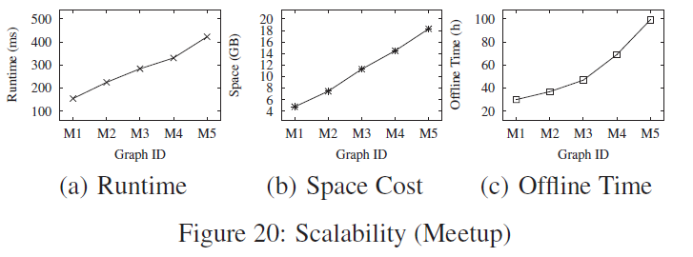
Distributed Algorithms on Exact Personalized PageRank
Experimental Results
Scalability

Slide 20
FUTURE WORKS
It use approximate algorithm to find hub nodes, the algorithm for PPV computation is still exact only if these nodes can separate the graph. A better way of selecting the hub nodes is an area of future work.

